Slide 1
CS5187: Vision & Image
Zhu Zhiyu
Tutorial 04: Image Matching and Transformations
Notes:
How about now?

Slide 2
Key Concepts Covered:
Lecture 06: Feature Detection, Description (SIFT), and Matching.
Lecture 06: Evaluating matches (Invariance and Discriminability).
Lecture 07: Parametric transformations (Rotation, Scale, Translation).
Lecture 07: Inverse Image Warping for alignment.
Notes:
First, we should talk about what an image is.

Slide 3
（1）Implementing and Testing Descriptor Invariance
Concept: A robust feature descriptor should not change even if the image is geometrically or photometrically transformed. We will test this by extracting features from a base image and comparing them against a rotated and scaled version of the same image.
Experiment Steps:
Load a base image and convert it to grayscale.
Apply a geometric transformation (e.g., rotation by $45^\circ$ and a $0.5\times$ scale).
Extract SIFT keypoints and descriptors from both images.
Match them and calculate the percentage of successful matches to validate invariance.
Notes:
First, we should talk about what an image is.

Slide 4
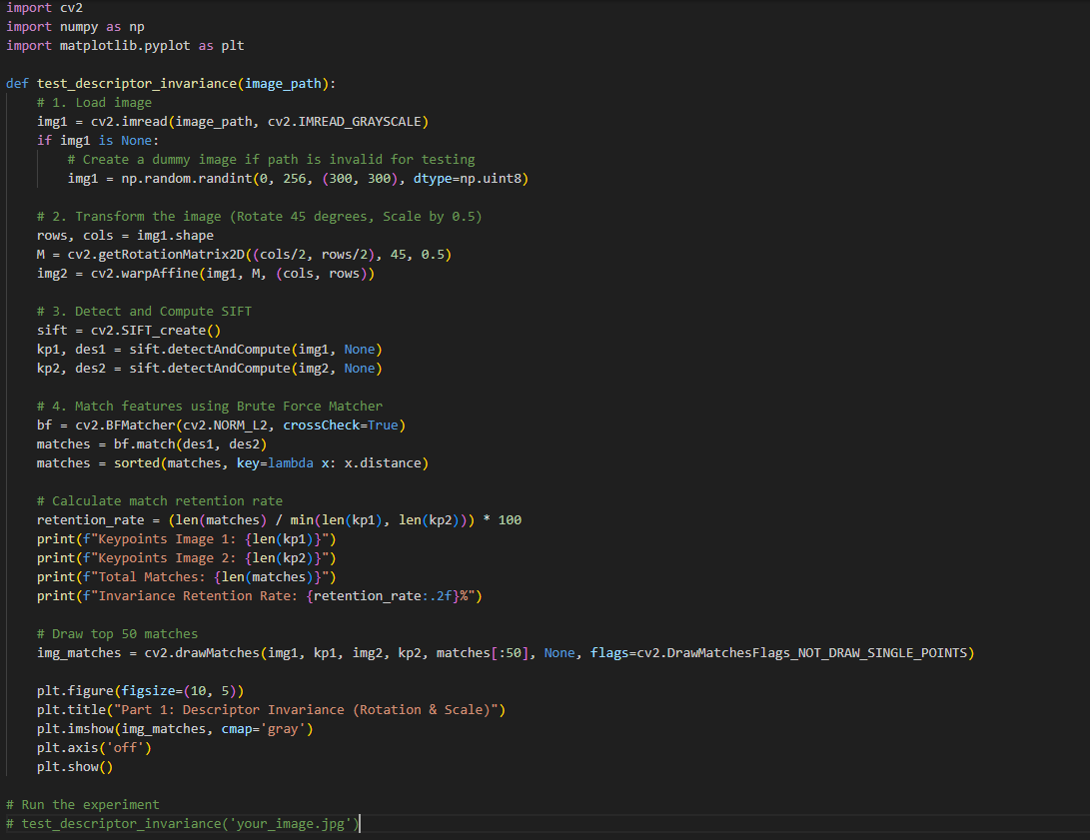
（1）Implementing and Testing Descriptor Invariance
Notes:
First, we should talk about what an image is.

Slide 5
（2）Image matching
Concept:
Finding similar descriptors between two different images (e.g., from different viewpoints). As discussed by standard distance thresholding can yield many false positives. We will use the Ratio Test to measure the distance ratio between the closest and second-closest match.
Experiment Steps:
Extract SIFT descriptors for two overlapping images.
Use K-Nearest Neighbors (KNN) matching with $k=2$.
Apply Lowe's ratio test: Keep the match if distance(1st) < 0.75 * distance(2nd).
Visualize the inlier matches.
Notes:
First, we should talk about what an image is.

Slide 6
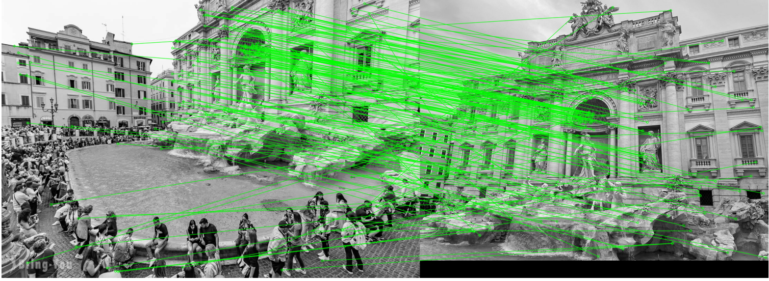
（2）Image matching
Notes:
First, we should talk about what an image is.

Slide 7
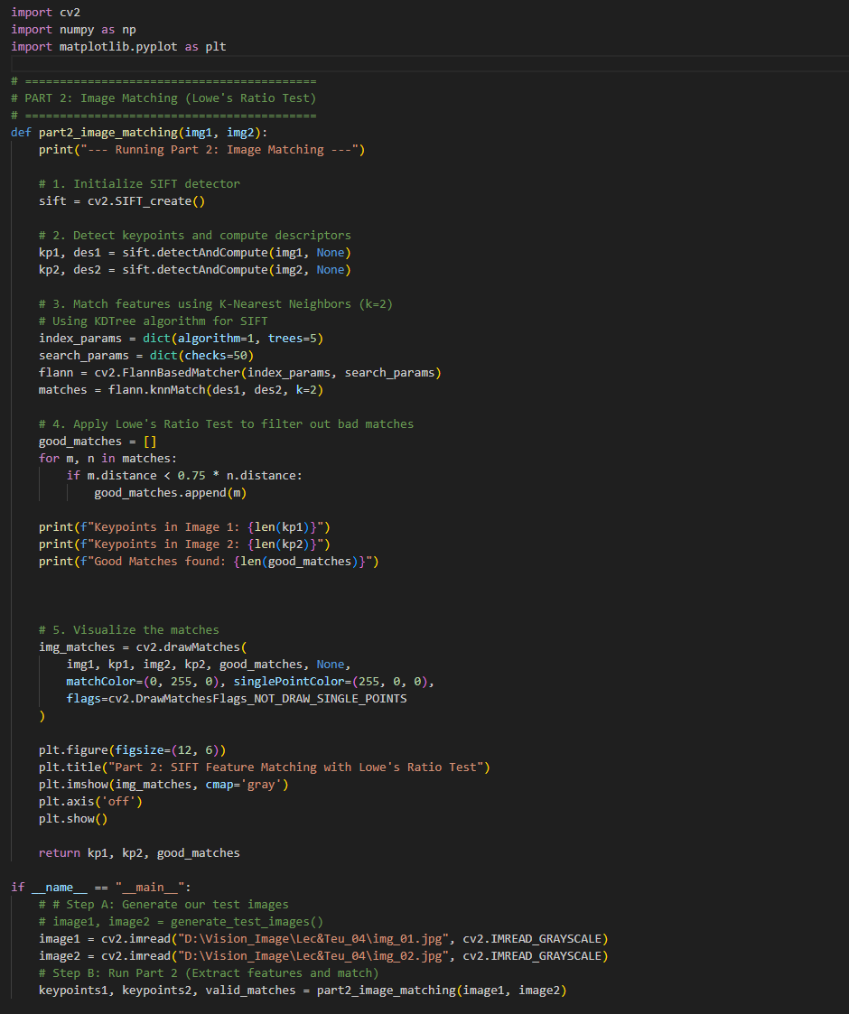
（2）Image matching
Notes:
First, we should talk about what an image is.

Slide 8
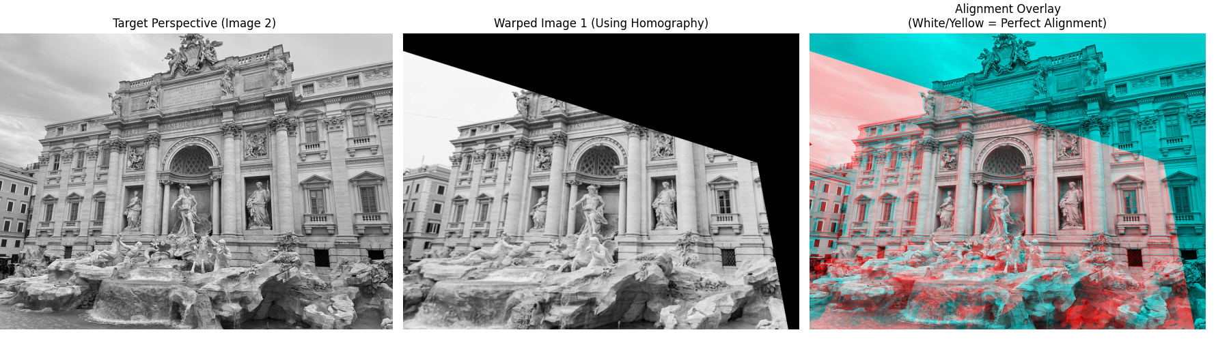
（3）Image Warping and Alignment
Notes:
First, we should talk about what an image is.

Slide 9
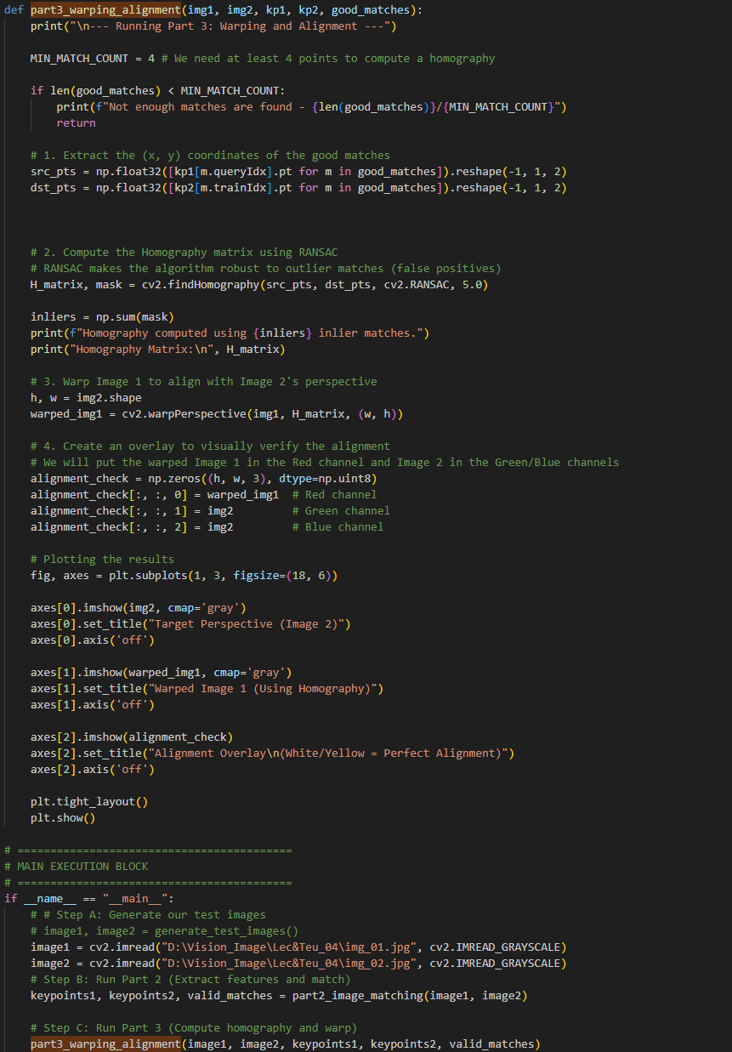
（3）Image Warping and Alignment
Notes:
First, we should talk about what an image is.

